Slide 1
Fall, 2021
Lecture 03: Topic in Differentiation

Slide 2
Contents
1
Higher-Order Derivatives
2
Implicit Differentiation
3
Derivative of logarithmic & exponential function
4
Related rate
5
Differentials & Local linear approximation
6
L’Hôpital’s rule

Slide 3
HIGHER-ORDER DERIVATIVES

Slide 4
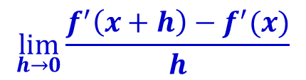
Higher Order derivatives
The derivative f ′ of a function f is also a function.
As such, f ′ may also be differentiated.
Thus, the function f ′ has a derivative f ″ at a point x in the domain of f if the limit of the quotient
exists as h approaches zero.
The function f ″ obtained in this manner is called the second derivative of the function f, just as the derivative f ′ of f is often called the first derivative of f.
By the same token, you may consider the third, fourth, fifth, etc. derivatives of a function f.
$$\lim_{h→0}{\frac{f^{′}\left(x+h\right)−f^{′}(x)}{h}}$$

Slide 5
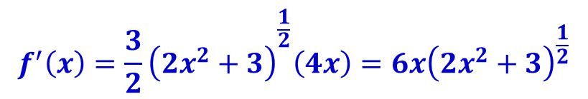
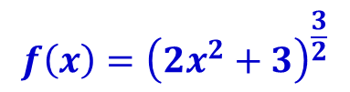
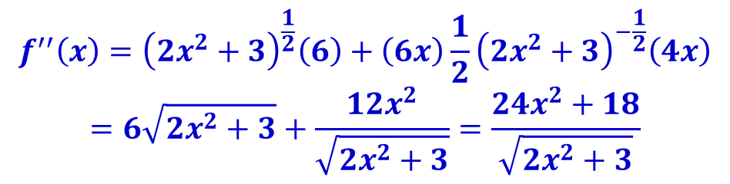
Higher Order derivatives: Example
$$f\left(x\right)={\left(2x^{2}+3\right)}^{\frac{3}{2}}$$
Find the second derivative of the function
Solution:
Firstly, we find the first derivative:
Then, we find the second derivative:
$$f^{′}\left(x\right)={\frac{3}{2}\left(2x^{2}+3\right)}^{\frac{1}{2}}\left(4x\right)=6x{\left(2x^{2}+3\right)}^{\frac{1}{2}}$$
$$f^{′′}\left(x\right)={\left(2x^{2}+3\right)}^{\frac{1}{2}}\left(6\right)+\left(6x\right)\frac{1}{2}{\left(2x^{2}+3\right)}^{−\frac{1}{2}}\left(4x\right)$$
$$=6\sqrt{2x^{2}+3}+\frac{12x^{2}}{\sqrt{2x^{2}+3}}=\frac{24x^{2}+18}{\sqrt{2x^{2}+3}}$$

Slide 6
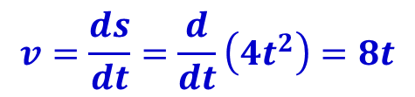

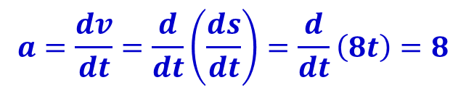
Higher Order derivatives: Applied example
The distance s (in feet) covered by a prototype train moving along a straight track t seconds after starting from rest is given by the function: What is the train’s acceleration after 30 seconds?
Solution:
The velocity of the train t seconds from rest is given by:
The acceleration of the train t seconds from rest is given by the rate of change of the velocity of t, given by:
$$s\left(t\right)=4t^{2}$$
$$v=\frac{ds}{dt}=\frac{d}{dt}\left(4t^{2}\right)=8t$$
$$a=\frac{dv}{dt}=\frac{d}{dt}\left(\frac{ds}{dt}\right)=\frac{d}{dt}\left(8t\right)=8$$

Slide 7
Implicit differentiation

Slide 8

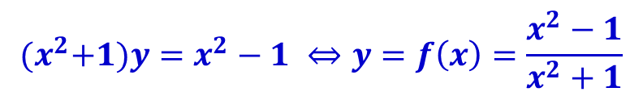
Function defined explicitly and implicitly
Up to now we have dealt with functions in the form
y = f(x)
That is, the dependent variable y has been expressed explicitly in terms of the independent variable x.
However, not all functions are expressed explicitly.
For example, consider
This equation expresses y implicitly as a function of x.
Solving for y in terms of x we get
which expresses y explicitly.
$$x^{2}y+y−x^{2}+1=0$$
$${(x}^{2}+1)y=x^{2}−1 ⇔y=f\left(x\right)=\frac{x^{2}−1}{x^{2}+1}$$

Slide 9

Function defined explicitly and implicitly
Now, consider the equation
With certain restrictions placed on y and x, this equation defines y as a function of x.
But in this case it is difficult to solve for y in order to express the function explicitly.
How do we compute dy/dx in this case?
The chain rule gives us a way to do this.
$$y^{4}−y^{3}−y+{2x}^{3}−x=8$$

Slide 10
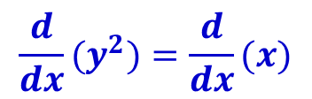

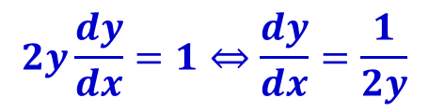
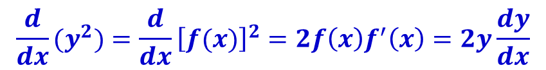
Implicit differentiation
Consider the equation
To find dy/dx, we differentiate both sides of the equation:
Since y is a function of x, we can rewrite y = f(x) and find:
Now, we have:
$$y^{2}=x$$
$${\frac{d}{dx}(y}^{2})=\frac{d}{dx}(x)$$
$${\frac{d}{dx}(y}^{2})=\frac{d}{dx}{\left[f(x)\right]}^{2}=2f\left(x\right)f^{′}\left(x\right)=2y\frac{dy}{dx}$$
$$2y\frac{dy}{dx}=1⇔\frac{dy}{dx}=\frac{1}{2y}$$

Slide 11



Implicit differentiation: The steps
To find by implicit differentiation:
Differentiate both sides of the equation with respect to x. (Make sure that the derivative of any term involving y includes the factor )
Solve the resulting equation for in terms of x and y.
$$\frac{dy}{dx}$$
$$\frac{dy}{dx}$$
$$\frac{dy}{dx}$$

Slide 12




Implicit differentiation: Example
$$\frac{dy}{dx}$$
Find for the equation
Solution:
Differentiating both sides and solving for we get
$$y^{4}−y^{3}−y+{2x}^{3}−x=8$$
$$\frac{dy}{dx}$$
$$\frac{d}{dx}\left(y^{4}−y^{3}−y+{2x}^{3}−x\right)=\frac{d}{dx}\left(8\right)$$
$$⇔\frac{d}{dx}\left(y^{4}\right)−\frac{d}{dx}\left(y^{3}\right)−\frac{dy}{dx}+\frac{d}{dx}\left(2x^{3}\right)−\frac{d}{dx}\left(x\right)=0$$ $$⇔4y^{3}\frac{dy}{dx}−3y^{2}\frac{dy}{dx}−\frac{dy}{dx}+6x^{2}−1=0$$
$$⇔\frac{dy}{dx}\left(4y^{3}−{3y}^{2}−1\right)=1−6x^{2}$$ $$⇔\frac{dy}{dx}=\frac{1−6x^{2}}{4y^{3}−{3y}^{2}−1}$$

Slide 13
THE DERIVATIVE OF logarithmic & exponential function

Slide 14
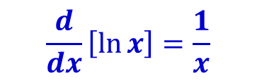
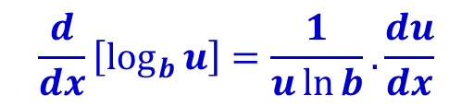
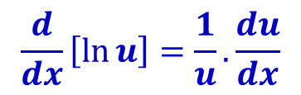
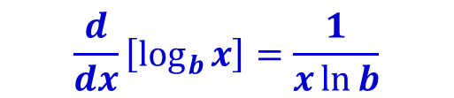
Derivative of Logarithmic Function
Rule 9: Derivative of logarithmic functions If u is a differentiable function of x (u=f(x)), then
$$\frac{d}{dx}\left[\ln{x}\right]=\frac{1}{x}$$
$$\frac{d}{dx}\left[\log_{b}{x}\right]=\frac{1}{x\ln{b}}$$
$$\frac{d}{dx}\left[\ln{u}\right]=\frac{1}{u}.\frac{du}{dx}$$
$$\frac{d}{dx}\left[\log_{b}{u}\right]=\frac{1}{u\ln{b}}.\frac{du}{dx}$$
See textbook for the proof of this theorem.
Page 14

Slide 15


Derivative of Logarithmic Function: Example
Find the derivative of:
$$f\left(x\right)=\ln{(x^{2}+1)}$$
$$f\left(x\right)=\ln{\frac{x^{2}\sin{x}}{\sqrt{1+x}}}$$

Slide 16
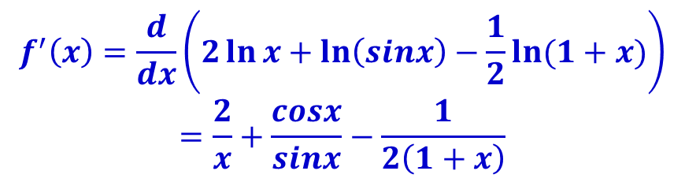

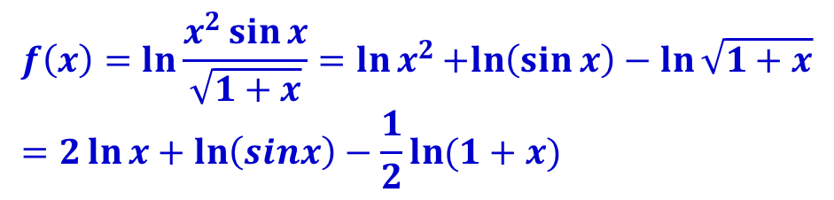
Derivative of Logarithmic Function: Example
Solution:
$$f\left(x\right)=\ln{(x^{2}+1)}$$
$$with u=x^{2}+1 we have \\ \frac{d}{dx}\left[\ln\left(x^{2}+1\right)\right]=\frac{1}{x^{2}+1}.\frac{d}{dx}\left(x^{2}+1\right)=\frac{2x}{x^{2}+1}$$
$$f\left(x\right)=\ln{\frac{x^{2}\sin{x}}{\sqrt{1+x}}=\ln{x^{2}}+ln\left(\sin{x}\right)−\ln{\sqrt{1+x}}} \\ =2\ln{x}+\ln\left(sinx\right)−\frac{1}{2}\ln{(1+x)}$$
$$f^{′}\left(x\right)=\frac{d}{dx}\left(2\ln{x}+\ln\left(sinx\right)−\frac{1}{2}\ln{(1+x)}\right)$$
$$=\frac{2}{x}+\frac{cosx}{sinx}−\frac{1}{2\left(1+x\right)}$$

Slide 17
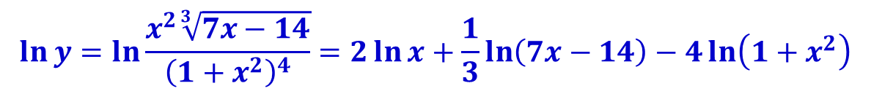
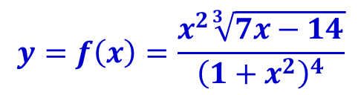
Logarithmic differentiation techniques
We now consider a technique called logarithmic differentiation that is useful for differentiating functions that are composed of products, quotients, and power.
Consider function f(x):
Directly calculating f’(x) is really complex and messy.
However, if we first take the nature logarithm of both sides, then we have:
Differentiating both sides with respect to x
$$y=f\left(x\right)=\frac{x^{2}\sqrt[3]{7x−14}}{{\left(1+x^{2}\right)}^{4}}$$
$$\ln{y}=\ln{\frac{x^{2}\sqrt[3]{7x−14}}{{\left(1+x^{2}\right)}^{4}}}=2\ln{x}+\frac{1}{3}\ln\left(7x−14\right)−4\ln\left(1+x^{2}\right)$$

Slide 18


Logarithmic differentiation techniques
Differentiating both sides with respect to x
$$\ln{y}=\ln{\frac{x^{2}\sqrt[3]{7x−14}}{{\left(1+x^{2}\right)}^{4}}}=2\ln{x}+\frac{1}{3}\ln\left(7x−14\right)−4\ln\left(1+x^{2}\right)$$
$$\frac{d}{dx}\left[\ln{y}\right]=\frac{d}{dx}\left[2\ln{x}+\frac{1}{3}\ln\left(7x−14\right)−4\ln\left(1+x^{2}\right)\right]$$ $$⇔\frac{1}{y}\frac{dy}{dx}=\frac{2}{x}+\frac{7}{3\left(7x−14\right)}−\frac{8x}{1+x^{2}}$$
$$⇔\frac{dy}{dx}=y\left[\frac{2}{x}+\frac{7}{3\left(7x−14\right)}−\frac{8x}{1+x^{2}}\right]$$ $$=\left[\frac{x^{2}\sqrt[3]{7x−14}}{{\left(1+x^{2}\right)}^{4}}\right]\left[\left[\frac{2}{x}+\frac{7}{3\left(7x−14\right)}−\frac{8x}{1+x^{2}}\right]\right]$$

Slide 19
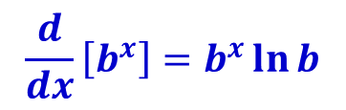
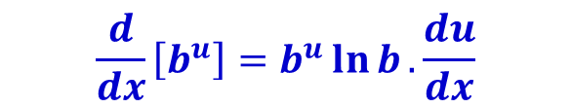
Derivative of Exponential Function
Rule 10: Derivative of exponential functions If u is a differentiable function of x (u=f(x)), then
$$\frac{d}{dx}\left[b^{x}\right]=b^{x}\ln{b}$$
$$\frac{d}{dx}\left[b^{u}\right]=b^{u}\ln{b}.\frac{du}{dx}$$
See textbook for the proof of this theorem.
Page 19

Slide 20



Derivative of Exponential Function: Example
Find the derivative of:
Solution:
Let,
$$f\left(x\right)={\left(3\right)}^{\sin{x}}$$
$$u=\sin{x}$$
$$\frac{d}{dx}\left(3^{u}\right)={\left(3\right)}^{u}\ln{3\frac{du}{dx}}={\left(3\right)}^{u}\ln{3\frac{d}{dx}\left(sinx\right)={\left(3\right)}^{u}\ln{3\cos{x}}}$$
$$f^{′}(x)=\ln{3{.\left(3\right)}^{sinx}.\cos{x}}$$

Slide 21
Related rates

Slide 22
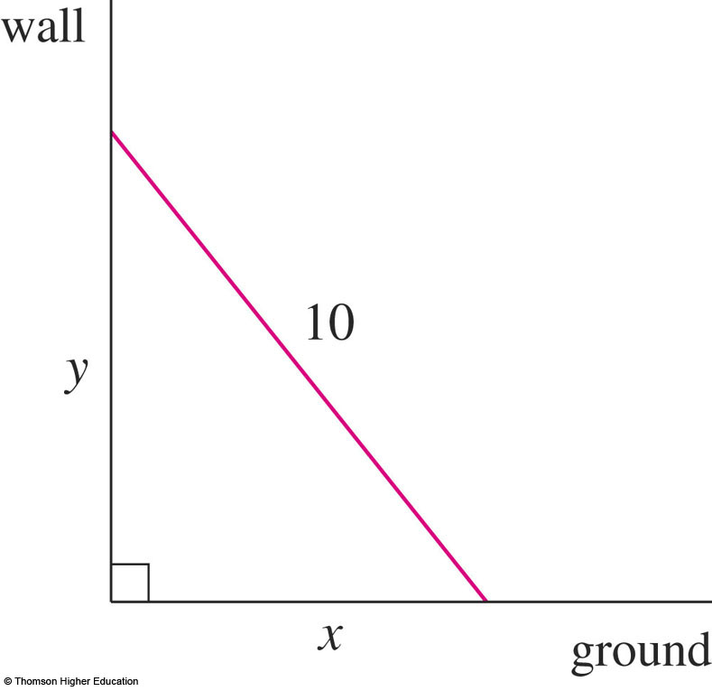
Related rates problem
In a related-rates problem, the idea is to compute the rate of change of one quantity in terms of the rate of change of another quantity—which may be more easily measured.
Consider the following examples:
A ladder 10 ft long rests against a vertical wall. If the bottom of the ladder slides away from the wall at a rate of 1 ft/s, how fast is the top of the ladder sliding down the wall when the bottom of the ladder is 6 ft from the wall?

Slide 23
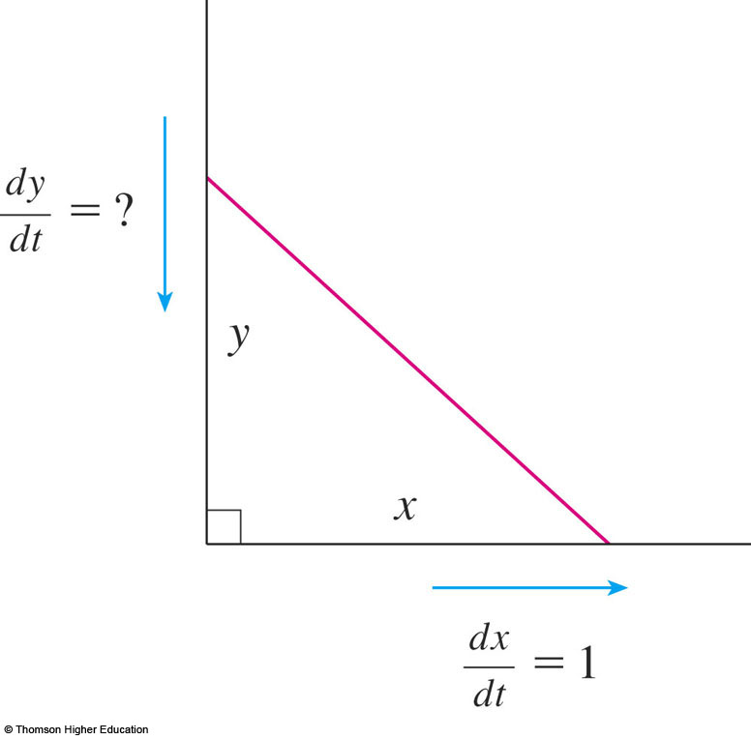
Related rates problem
Let x feet be the distance from the bottom of the ladder to the wall and y feet the distance from the top of the ladder to the ground.
Note that x and y are both functions of t (time, measured in seconds).
We are given that dx / dt = 1 ft/s and we are asked to find dy / dt when x = 6 ft.

Slide 24
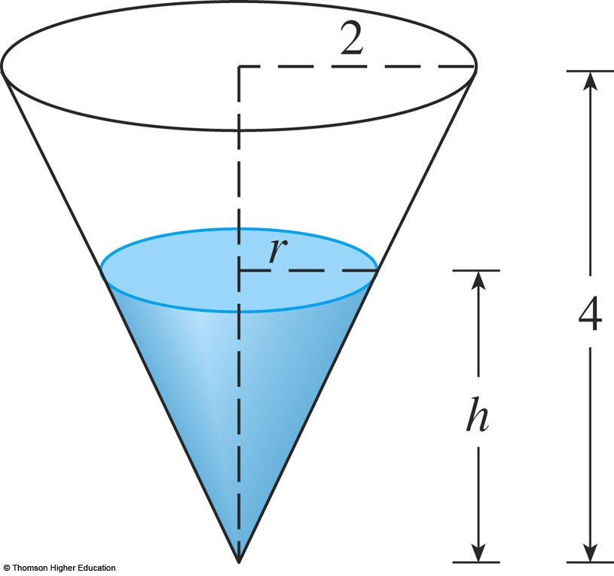
Related rates problem
A water tank has the shape of an inverted circular cone with base radius 2m and height 4 m.
If water is being pumped into the tank at a rate of 2m³/min, find the rate at which the water level is rising when the water is 3m deep.
We can sketch the cone and label it.
V is the volume of the water.
r is the radius of the surface.
h is the height of the water at time t, where t is measured in minutes.

Slide 25
Related rates problem
We are given that dV / dt = 2m³/min and we are asked to find dh / dt when h is 3 m.

Slide 26
Guidelines to solve related-rate problems
Assign a variable to each quantity.
Write the given values of the variables and their rate of change with respect to t.
Find an equation giving the relationship between the variables.
Differentiate both sides of the equation implicitly with respect to t.
Replace the variables and their derivatives by the numerical data found in step 2 and solve the equation for the required rate of change.
Page 26

Slide 27
Solve related rates problem: Example
Consider the ladder problem before.
Solution:
Step 1: Let x feet be the distance from the bottom of the ladder to the wall and y feet the distance from the top of the ladder to the ground.
Step 2: We are given that dx / dt = 1 ft/s and we are asked to find dy / dt when x = 6 ft.
Step 3: The relationship between x and y is given by the Pythagorean theorem: x² + y² = 100

Slide 28

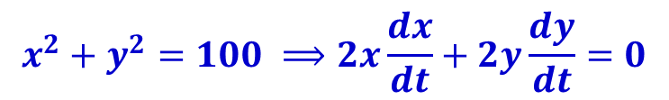
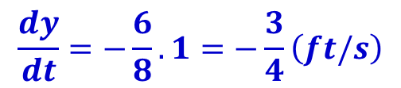
Solve related rates problem: Example
Solution:
Step 4: Differentiating each side of the equation with respect to t using the chain rule, we have:
Step 5: Solving this equation for the required rate, we obtain: When x = 6, the Pythagorean theorem gives y = 8 and so, substituting these values and dx / dt = 1, we have:
dy / dt is negative means that the distance from the top of the ladder to the ground is decreasing (the top is going down) at a rate of ¾ ft/s.
$$x^{2}+y^{2}=100 ⟹2x\frac{dx}{dt}+2y\frac{dy}{dt}=0$$
$$\frac{dy}{dt}=−\frac{x}{y}.\frac{dx}{dt}$$
$$\frac{dy}{dt}=−\frac{6}{8}.1=−\frac{3}{4}\left(ft/s\right)$$

Slide 29

Solve related rates problem: Applied Example
A study conducted by the National Association of Bank and Apartment Building estimates that the number of apartments in Ha Noi, N(t) (in millions), over the next 5 years is related to the interest rate r(t) (percent per year) by the equation:
What is the rate of change of the number of apartments with respect to time when the interest rate is 11% per year and is increasing at the rate of 1.5% per year?
$${9n}^{2}+r=36$$

Slide 30

Solve related rates problem: Applied Example
Solution:
Step 1&2: Let N(t) is the number of apartments, r(t) is the interest rate. We are given that r = 11% and dr/dt = 1.5 at a certain instant in time, and we are required to find dN/dt.
Step 3: The relationship between N(t) and r(t) is:
Step 4: Differentiating each side of the equation with respect to t using the chain rule, we have:
$${9N}^{2}+r=36$$
$$\frac{d}{dt}\left(9N^{2}\right)+\frac{dr}{dt}=0⇔18N\frac{dN}{dt}+\frac{dr}{dt}=0⟺\frac{dN}{dt}=−\frac{1}{18N}.\frac{dr}{dt}$$

Slide 31
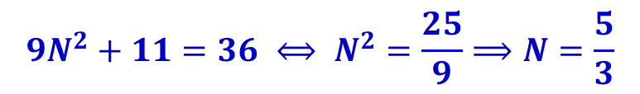
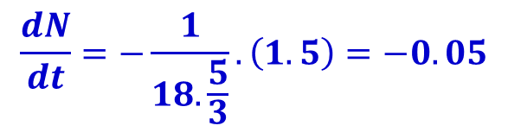
Solve related rates problem: Applied Example
Solution:
Step 5: When r=11, we have: Substitute N = 5/3 and dr/dt = 1.5 into this equation and solve for dN/dt:
Thus, at the time under consideration, the number of apartments in Ha Noi is decreasing at rate of 50,000 units per year.
$${9N}^{2}+11=36 ⟺ N^{2}=\frac{25}{9}⟹N=\frac{5}{3}$$
$$\frac{dN}{dt}=−\frac{1}{18.\frac{5}{3}}.\left(1.5\right)=−0.05$$

Slide 32
Differentials

Slide 33
Increments
Let x denote a variable quantity and suppose x changes from x₁ to x₂.
This change in x is called the increment in x and is denoted by the symbol Δx (read “delta x”).
Thus,
Δx = x₂ – x₁
Note that Δx can be either positive or negative

Slide 34
Increments
Now, suppose two quantities, x and y, are related by an equation y = f(x), where f is a function.
If x changes from x to x + Δx, then the corresponding change in y is called the increment in y.
It is denoted Δy and is defined by:
Δy = f(x + Δx) – f(x)
y
f(x + Δx)
Δy
f(x)
x
x
x + Δx
Δx

Slide 35
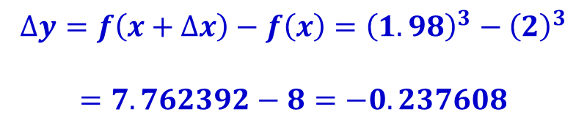
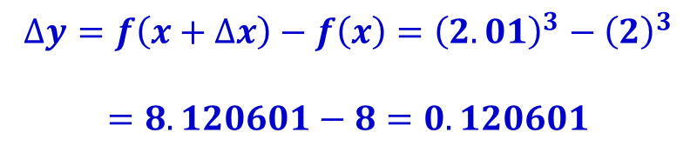
Increments: Example
Let y = x³.
Find Δx and Δy when x changes
from 2 to 2.01, and
from 2 to 1.98.
Solution
Here, Δx = 2.01 – 2 = 0.01
Next,
Here, Δx = 1.98 – 2 = – 0.02
Next,
$$∆y=f\left(x+∆x\right)−f\left(x\right)={\left(2.01\right)}^{3}−{\left(2\right)}^{3}$$ $$=8.120601−8=0.120601$$
$$∆y=f\left(x+∆x\right)−f\left(x\right)={\left(1.98\right)}^{3}−{\left(2\right)}^{3}$$ $$=7.762392−8=−0.237608$$

Slide 36
Differentials
We can obtain a relatively quick and simple way of approximating Δy, the change in y due to small change Δx.
Observe below that near the point of tangency P, the tangent line T is close to the graph of f.
Thus, if Δx is small, then dy is a good approximation of Δy.
y
T
f(x + Δx)
Δy
P
dy
f(x)
x
x
x + Δx
Δx

Slide 37
Differentials
Notice that the slope of T is given by dy/Δx.
But the slope of T is given by f ′(x), so we have
dy/Δx = f ′(x) or dy = f ′(x) Δx
Thus, we have the approximation:
Δy ≈ dy = f ′(x)Δx
The quantity dy is called the differential of y.
y
T
f(x + Δx)
Δy
P
dy
f(x)
x
x
x + Δx
Δx

Slide 38
Differentials
Let y = f(x) define a differentiable function x. Then
The differential dx of the independent variable x is: dx = Δx
The differential dy of the dependent variable y is. dy = f ′(x)Δx = f ′(x)dx
Page 38

Slide 39

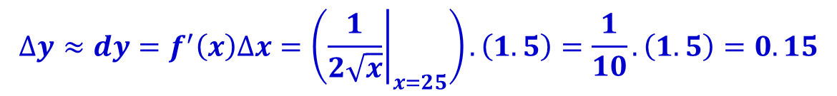

Differentials: Example
Approximate the value of using differentials.
Solution
Let’s consider the function
Since 25 is the number nearest 26.5 whose square root is readily recognized, let’s take x = 25.
We want to know the change in y, Δy, as x changes from x = 25 to x = 26.5, an increase of Δx = 1.5.
So we find
Therefore,
$$\sqrt{26.5}$$
$$y=f\left(x\right)=\sqrt{x}$$
$$∆y≈dy=f^{′}\left(x\right)∆x=\left({\left.\frac{1}{2\sqrt{x}}\right|}_{x=25}\right).\left(1.5\right)=\frac{1}{10}.\left(1.5\right)=0.15$$
$$\sqrt{26.5}−\sqrt{25}=∆y≈0.15⟹\sqrt{26.5}≈5+0.15≈5.15$$

Slide 40
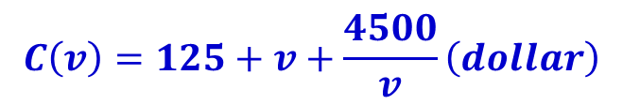
Differentials: Applied Example
Effect of Speed on Vehicular Operating.
The total cost incurred in operating a certain type of truck on a 500-km trip, traveling at an average speed of v km/h, is estimated to be:
Find the approximate change in the total operating cost when the average speed is increased from 55 to 60 km/h.
$$C\left(v\right)=125+v+\frac{4500}{v}\left(dollar\right)$$

Slide 41

Differentials: Applied Example
Effect of Speed on Vehicular Operating.
Solution:
Total operating cost is given by
With v = 55 an Δv = dv = 5, we find: so the total operating cost is found to decrease by $2.43.
This might explain why so many independent truckers often exceed the 55 km/h speed limit.
$$C\left(v\right)=125+v+\frac{4500}{v}\left(dollar\right)$$
$$∆C=dC=C^{′}\left(v\right)dv={\left.\left(1−\frac{4500}{v^{2}}\right)\right|}_{v=55}.\left(5\right)=\left(1−\frac{4500}{3025}\right).\left(5\right)≈−2.43$$

Slide 42
L’Hôpital’s rule

Slide 43
Self Learning
Read textbook Chapter 3, Section 3.6 – L’Hôpital’s rule (page 219-225).

Slide 44
Summary
Describe higher-order derivative of a function and it’s applications.
Introduce to function defined implicitly and implicit differentiation.
Derivatives of logarithmic & exponential functions.
Introduce to related rate, the steps to find related rate. Practical and applied examples are also described.
Differential and approximate functions using differentials
L’Hôpital’s rule.

Slide 45
Homework
Problem Set:
Read sections 3.1 - 3.6 in Chapter 3. Test with some exercises at the end of each section (students should do as much as possible)
Read Study guide for topic 4.
Exercise 1 to 36, 45, 49, 52, 55 -> 58, 60, 62 in textbook page 228-230 (chapter 3 review exercise) – except the CAS exercises.
References
[1] H. Anton, I. Bivens, S. Davis, Calculus - Early Transcendentals, 9th Ed., MA, USA: John Wiley & Sons, Inc., 2009.

